Slide 1
A Gestão no ambiente global
4

Slide 2
objetivos
Contrastar as atitudes etnocêntricas, policêntricas, e geocêntricas face à globalização.
Conhecer a importância das alianças e mecanismos de comércio.
Descrever as estruturas e técnicas que as organizações usam no processo de internacionalização.
Explicar a relevância do ambiente politico-legal, económico, e cultural para a gestão global.

Slide 3
Perspetivas dos gestores face à globalização
Paroquialismo – visão limitada, utilizando apenas a perspetiva pessoal e que leva à incapacidade de reconhecer diferenças entre pessoas.
Etnocentrismo – crença de que as práticas de gestão do próprio país (país de origem) são as melhores.
Notes:
Monolingualism is one sign that a nation suffers from parochialism—viewing the world solely through one’s own eyes and perspectives. People with a parochial attitude do not recognize that others have different ways of living and working. They ignore others’ values and customs and rigidly apply an attitude of “ours is better than theirs” to foreign cultures.
This type of narrow, restricted attitude is one approach that managers might take, but it isn’t the only one. In fact, there are three possible global attitudes. Let’s look at each more closely.
First, an ethnocentric attitude is the belief that the best work approaches and practices are those of the home country (the country in which the company’s parochialistic headquarters are located). Managers with an ethnocentric attitude believe that people in foreign countries don’t have the needed skills, expertise, knowledge, or experience to make the best business decisions as people in the home country do.

Slide 4
Perspetivas dos gestores face à globalização
Policentrismo – crença que os gestores de cada país conhecem as práticas de gestão mais apropriadas para esse país, sendo essas as práticas que devem ser adotadas.
Geocentrismo - visão orientada para o mundo, defende a adoção das melhores práticas, independentemente do país de origem, ao conjunto da organização.
(ex: Custos Chineses, Qualidade Japonesa, Design Europeu, Marketing Americano).
Notes:
A polycentric attitude is the view that employees in the host country (the foreign country in which the organization is doing business) know the best work approaches and practices for running their business. Managers with this attitude view every foreign operation as different and hard to understand. Thus, they’re likely to let employees there figure out how best to do things.
A geocentric attitude is a world-oriented view that focuses on using the best approaches and people from around the globe. Managers with this type of attitude have a global view and look for the best approaches and people regardless of origin.

Slide 5
Ambiente global alianças internacionais
União Europeia (UE) / European Union (EU)
União de 27 países Europeus, em termos económicos e comerciais.
Notes:
Global competition and the global economy are shaped by regional trading agreements, including the European Union (EU), North American Free Trade Agreement (NAFTA), the Association of Southeast Asian Nations (ASEAN), and others.
The European Union (EU) is an economic and political partnership of 28 democratic European countries. Eight countries (Croatia, the former Yugoslav Republic of Macedonia, Turkey, Albania, Bosnia-Herzegovina, Iceland, Montenegro, and Serbia) are candidates to join the EU.
When the 12 original members formed the EU in 1992, the primary motivation was to reassert the region’s economic position against the United States and Japan. Before then, each European nation had border controls, taxes, and subsidies; nationalistic policies; and protected industries. Now with these barriers removed, the economic power represented by the EU is considerable. Its current membership covers a population base of more than half a billion people (7 percent of the world population) and accounts for approximately 20 percent of the world’s global exports and imports.
Another step toward full unification occurred when the common European currency, the euro, was adopted. The euro is currently in use in 18 of the 28 member states, and all new member countries must adopt the euro. Only Denmark, the United Kingdom, and Sweden have been allowed to opt out of using the euro.

Slide 6
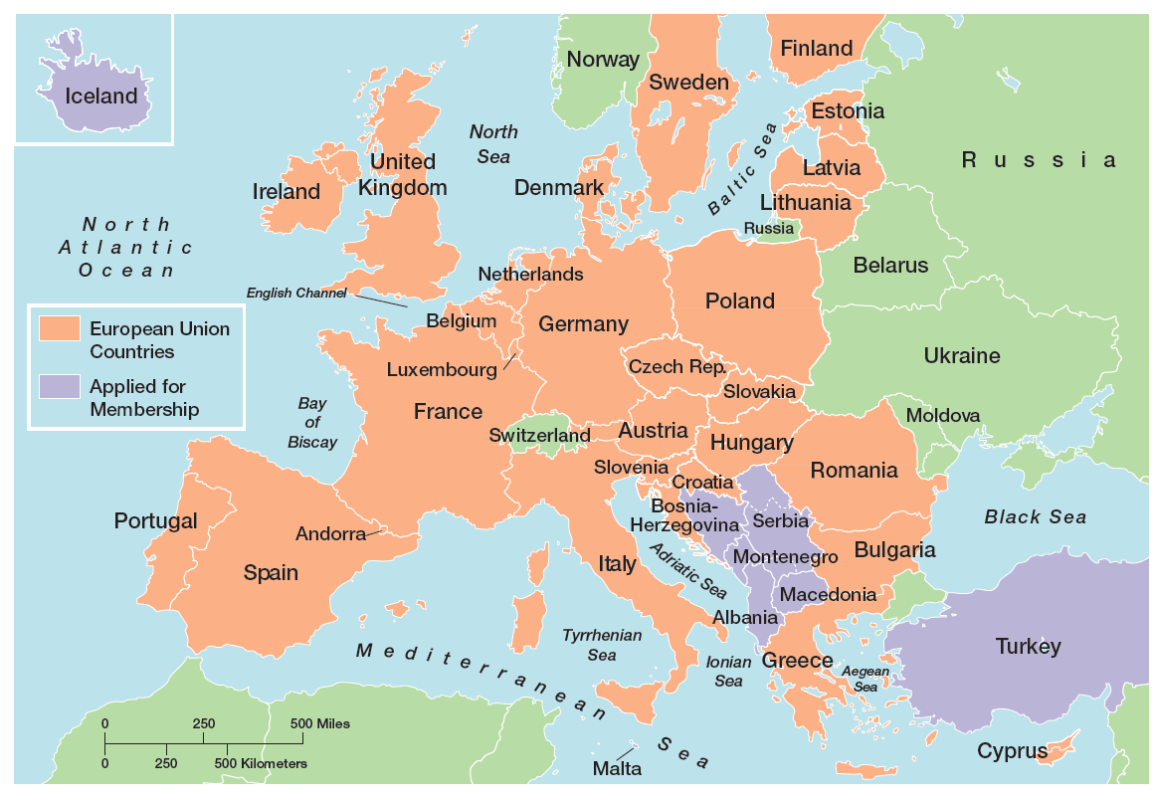
figura 4-1
Mapa da união europeia
Notes:
Exhibit 4-1 shows the 28 democratic European countries that comprise the European Union. The last couple of years were economically difficult for the EU and its members, as they were for many global regions. However, things are looking up. The economic recovery, which began mid-2013, is expected to continue spreading across countries and gaining strength.

Slide 7
Alianças internacionais (cont.)
Tratado do Comércio Livre na América do Norte / North American Free Trade Agreement (NAFTA)
Acordo entre os governos do México, Canadá e Estados Unidos, para a eliminação de algumas barreiras comerciais.
Notes:
When agreements in key issues covered by the North American Free Trade Agreement (NAFTA) were reached by the Mexican, Canadian, and U.S. governments in 1992, a vast economic bloc was created. It is the second largest trade bloc in the world in terms of combined GDP of its members.
Between 1994, when NAFTA went into effect, and 2007 (the most recent year for complete statistics), merchandise trade between the United States and Canada has more than tripled, while trade between Mexico and the United States has more than quadrupled. Put into numbers, that translates to some $2.6 billion exchanged on a daily basis among NAFTA partners.
Other Latin American nations have also become part of free trade blocs. Colombia, Mexico, and Venezuela led the way when all three signed an economic pact in 1994 eliminating import duties and tariffs. Another agreement, the U.S.-Central America Free Trade Agreement (CAFTA), promotes trade liberalization between the United States and five Central American countries: Costa Rica, El Salvador, Guatemala, Honduras, and Nicaragua. However, only El Salvador and Costa Rica have joined.
However, another free trade bloc of 10 South American countries known as the Southern Common Market or Mercosur already exists. Some South Americans see Mercosur as an effective way to combine resources to better compete against other global economic powers, especially the EU and NAFTA. With the future of FTAA highly doubtful, this regional alliance could take on new importance.

Slide 8
Alianças internacionais (cont.)
Associação de Nações do Sudoeste Asiático / Association of Southeast Asian Nations (ASEAN)
Aliança comercial de 10 países do Sudoeste Asiático.
Notes:
The Association of Southeast Asian Nations (ASEAN ) is a trading alliance of 10 Southeast Asian nations (See Exhibit 4-2). The ASEAN region has a population more than 591 million with a combined GDP of US $1.5 trillion. In addition to these 10 nations, leaders from a group dubbed ASEAN+3, which include China, Japan, and South Korea, have met to discuss trade issues. Also, leaders from India, Australia, and New Zealand have participated in trade talks with ASEAN+3 as well. The main issue with creating a trade bloc of all 16 nations has been the lack of any push toward regional integration. Despite the Asian culture’s emphasis on consensus building, “ASEAN’s biggest problem is that individual members haven’t been willing to sacrifice for the common good.”

Slide 9
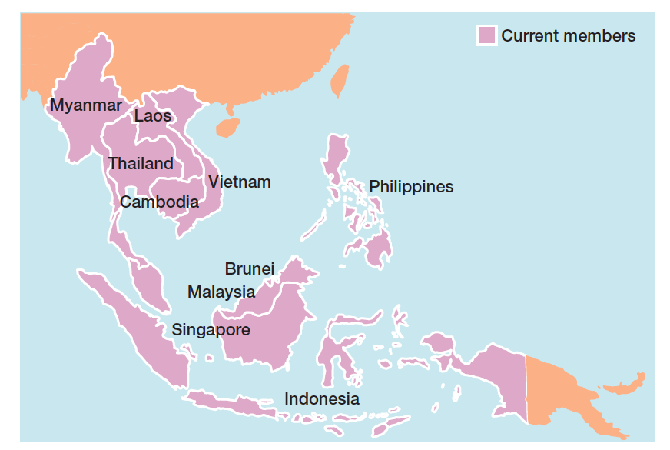
figura 4-2 mapa ASEAn
Notes:
Despite the barriers and challenges, progress toward regional integration continues. This fast-growing region means ASEAN and other Asian trade alliances will be increasingly important globally with an impact that eventually could rival that of both NAFTA and the EU.

Slide 10
Mecanismos de comércio global
Organização Mundial do Comércio (OMC) / World Trade Organization (WTO) – organização de 153 países, relativa às regras do comércio entre os países.
Fundo Monetário Internacional (FMI) / International Monetary Fund (IMF) - organização de 185 países que promove a cooperação monetária internacional e fornece aconselhamento, empréstimos, e assistência técnica.
Notes:
The World Trade Organization (WTO) is a global organization of 159 countries that deals with the rules of trade among nations. Formed in 1995, the WTO evolved from the General Agreement on Tariffs and Trade (GATT), a trade agreement in effect since the end of World War II. Today, the WTO is the only global organization that deals with trade rules among nations. Its membership consists of 159 member countries and 24 observer governments.
The International Monetary Fund (IMF) is an organization of 188 countries that promotes international monetary cooperation and provides member countries with policy advice, temporary loans, and technical assistance to establish and maintain financial stability and to strengthen economies. During the global financial turmoil of the last few years, the IMF has been on the forefront of advising countries and governments in getting through the difficulties.

Slide 11
Mecanismos de comércio global (Cont.)
Banco Mundial / World Bank Group – grupo de cinco instituições que fornece assistência técnica e financeiro a países em vias de desenvolvimento.
Organização para a Cooperação e o Desenvolvimento Económico (OCDE) / Organization for Economic Cooperation and Development (OECD) – organização que ajuda os seus 30 membros a atingir o crescimento e emprego sustentável.
Notes:
The World Bank Group is a group of five closely associated institutions, all owned by its member countries, that provides vital financial and technical assistance to developing countries around the world. The goal of the World Bank Group is to promote long-term economic development and poverty reduction by providing members with technical and financial support.
The forerunner of the OECD, the Organization for European Economic Cooperation, was formed in 1947 to administer American and Canadian aid under the Marshall Plan for the reconstruction of Europe after World War II. Today, the Organization for Economic Cooperation and Development (OECD) is a Paris-based international economic organization whose mission is to help its 34 member countries achieve sustainable economic growth and employment and raise the standard of living in member countries, while maintaining financial stability in order to contribute to the development of the world economy.

Slide 12
Tipos de organizações Internacionais
Multinacionais – Mantêm operações em vários países (termo genérico).
Multi-domésticas – Descentralizam a gestão e a tomada de decisão para cada país.
Globais – Centralizam a gestão e a decisão no país de origem.
Transnacionais ou sem fronteiras – Eliminam barreiras geográficas artificiais.
Notes:
Today, few companies don’t do business internationally. However, there’s not a generally accepted approach to describe the different types of international companies; different authors call them different things. The book authors use the terms multinational, multidomestic, global, and transnational.
A multinational corporation (MNC) is any type of international company that maintains operations in multiple countries. One type of MNC is a multidomestic corporation, which decentralizes management and other decisions to the local country. This type of globalization reflects the polycentric attitude. A multi-domestic corporation doesn’t attempt to replicate its domestic successes by managing foreign operations from its home country. Instead, local employees typically are hired to manage the business, and marketing strategies are tailored to that country’s unique characteristics.

Slide 13
Modos de penetração em mercados internacionais
Aprovisionamento global – Adquirir materiais e força de trabalho noutros países (e.g. nos países onde for mais barato).
Exportação – Vender produtos/serviços noutro país.
Importação – Adquirir produtos/serviços noutro país.
Notes:
When organizations do go international, they often use different approaches. Managers who want to get into a global market with minimal investment may start with global sourcing (also called global outsourcing), which is purchasing materials or labor from around the world, wherever it is cheapest. The goal: take advantage of lower costs in order to be more competitive.
The next step in going international may involve exporting the organization’s products to other countries—that is, making products domestically and selling them abroad.

Slide 14
Modos de penetração em mercados internacionais (Cont.)
Licenciamento - Dar a outra organização o direito de produzir ou vender os produtos, usando a mesma tecnologia e especificações.
Franchising – Dar a outra organização o direito de usar o nosso nome e métodos de operação.
Notes:
In addition, an organization might do importing, which involves acquiring products made abroad and selling them domestically. Both usually entail minimal investment and risk, which is why many small businesses often use these approaches to doing business globally.
Managers also might use licensing or franchising, which are similar approaches involving one organization giving another organization the right to use its brand name, technology, or product specifications in return for a lump sum payment or a fee usually based on sales. The only difference is that licensing is primarily used by manufacturing organizations that make or sell another company’s products and franchising is primarily used by service organizations that want to use another company’s name and operating methods.

Slide 15
Modos de penetração em mercados internacionais (Cont.)
Alianças estratégicas – Parcerias entre empresas de diferentes países, em que se partilham recursos e conhecimento para desenvolver novos produtos ou construir unidades de produção.
Joint Venture – Tipo específico de aliança estratégica em que os parceiros formam uma organização separada e independente, detida por ambos.
Notes:
When an organization has been doing business internationally for a while and has gained experience in international markets, managers may decide to make more of a direct foreign investment. One way to increase investment is through a strategic alliance, which is a partnership between an organization and a foreign company partner or partners in which both share resources and knowledge in developing new products or building production facilities. For example, Honda Motor and General Electric teamed up to produce a new jet engine.
A specific type of strategic alliance in which the partners form a separate, independent organization for some business purpose is called a joint venture. For example, Hewlett-Packard has had numerous joint ventures with various suppliers around the globe to develop different components for its computer equipment. These partnerships provide a relatively easy way for companies to compete globally.

Slide 16
Modos de penetração em mercados internacionais (Cont.)
- Filial estrangeira – Investimento direto num país estrangeiro, criando uma organização nesse país que funcionará como parte da organização multi-doméstica (controle local) ou global (controle centralizado).
Notes:
Finally, managers may choose to directly invest in a foreign country by setting up a foreign subsidiary as a separate and independent facility or office. This subsidiary can be managed as a multidomestic organization (local control) or as a global organization (centralized control). As you can probably guess, this arrangement involves the greatest commitment of resources and poses the greatest amount of risk.

Slide 17
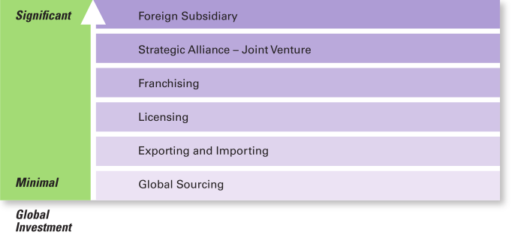
figura 4-3
Modos de penetração em mercados internacionais
Notes:
Exhibit 4-3 shows the different approaches to doing business internationally. Although global sourcing may be the first step to going international for many companies, they often continue to use this approach because of the competitive advantages it offers. Each successive stage of going international beyond global sourcing, however, requires more investment and thus entails more risk for the organization.

Slide 18
Desafios de atuar num ambiente global
Ambiente político-legal
  Necessidade de respeitar as leis de cada país.
  Incerteza quanto à estabilidade do governo e políticas atuais.
Ambiente económico
  Necessidade de ter em consideração diferentes taxas de câmbio, taxas de inflação, impostos locais.
  Diferentes atuações em economias de mercado e em economias centralizadas.
Notes:
U.S. managers are accustomed to a stable legal and political system. Changes tend to be slow, and legal and political procedures are well established. Elections are held at regular intervals, and even when the political party in power changes after an election, it’s unlikely that anything too radical will happen. The stability of laws allows for accurate predictions. However, this certainly isn’t true for all countries.
Managers must stay informed of the specific laws in countries where they do business. For instance, the president of Zimbabwe is pushing ahead with plans to force foreign companies to sell majority stakes to locals.
Also, some countries have risky political climates. For instance, BP could have warned Exxon about the challenges of doing business in Russia. During its long involvement in the country, BP has “had so many police run-ins that its stock price often nudges up or down in response to raids or the arrests of employees.”
Keep in mind that a country’s political/legal environment doesn’t have to be risky or unstable to be a concern to managers. Just the fact that it differs from that of the home country is important. Managers must recognize these differences if they hope to understand the constraints and opportunities that exist.

Slide 19
Desafios de atuar num ambiente global (Cont.)
Ambiente cultural
  Necessidade de adequação das práticas de gestão à realidade cultural de cada país.
  Modelo de Hofstede para analisar culturas.
  Modelo Globe (Global Leadership and Organizational Behaviour Effectiveness) para analisar culturas.
Notes:
As we know from Chapter 3, organizations have different cultures. Countries have cultures, too. National culture includes the values and attitudes shared by individuals from a specific country that shape their behavior and their beliefs about what is important. Legal, political, and economic differences among countries are fairly obvious. Getting information about cultural differences isn’t quite that easy! The primary reason? It’s difficult for natives to explain their country’s unique cultural characteristics to someone else.

Slide 20
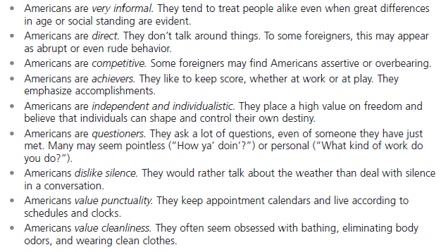
figura 4-4 como são os Americanos?

Slide 21
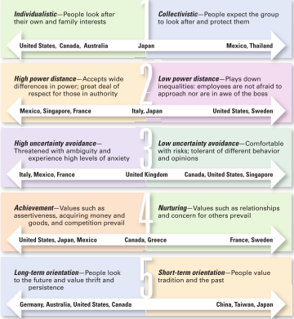
figura 4-5 modelo de Hofstede – cinco dimensões de cultura nacional
Notes:
Geert Hofstede developed one of the most widely referenced approaches to helping managers better understand differences between national cultures. His research found that countries vary on five dimensions of national culture. These dimensions are described in Exhibit 4-5 above, which also shows some of the countries characterized by those dimensions.

Slide 22
Modelo de hofstede
Individualismo-Coletivismo - grau em que as pessoas de um país preferem agir como indivíduos, ou como membros de grupos.
Distância Hierárquica - grau de desigualdade entre as pessoas considerado normal/aceitável ou não.
Controle da Incerteza – grau de preferência de situações estruturadas ou certas versus preferência por situações não estruturadas ou incertas.

Slide 23
Modelo de hofstede (Cont.)
Masculinidade - Feminilidade (Achievement–Nurturing) - Grau em que os valores de desempenho, sucesso material, e competição prevalecem sobre valores como a qualidade de vida, relações entre as pessoas e solidariedade.
Orientação p/ Longo Prazo – Orientação p/ Curto Prazo - grau em que os valores de longo prazo, como a poupança e a persistência prevalecem sobre valores de curto prazo.

Slide 24
Modelo globe
Assertividade (= Masculinidade)
Orientação para o futuro (= Orientação para o longo prazo)
Individualismo-Colectivismo (=)
Distância hierárquica (=)
Controle da incerteza (=)
Orientação humanística (= Feminilidade)
Notes:
The Global Leadership and Organizational Behavior Effectiveness (GLOBE) program is an ongoing research program that extended Hofstede’s work by investigating cross-cultural leadership behaviors and giving managers additional information to help them identify and manage cultural differences. Using data from more than 18,000 managers in 62 countries, the GLOBE research team (led by Robert House) identified nine dimensions on which national cultures differ.
Two dimensions (power distance and uncertainty avoidance) fit directly with Hofstede’s. Four are similar to Hofstede’s (assertiveness, which is similar to achievement-nurturing; humane orientation, which is similar to the nurturing dimension; future orientation, which is similar to long-term and short-term orientation; and institutional collectivism, which is similar to individualism-collectivism). The remaining three (gender differentiation, in-group collectivism, and performance orientation) offer additional insights into a country’s culture.
The GLOBE studies confirm that Hofstede’s dimensions are still valid and extend his research rather than replace it. GLOBE’s added dimensions provide an expanded and
updated measure of countries’ cultural differences. It’s likely that cross-cultural studies of human behavior and organizational practices will increasingly use the GLOBE
dimensions to assess differences between countries.

Slide 25
Modelo globe (CONT.)
Orientação para o desempenho – Grau em que uma sociedade encoraja e recompensa os membros por melhorias e excelência.
Coletivismo nos próprios grupos – Grau em que as pessoas se orgulham dos pequenos grupos a que pertencem (família, amigos, organizações).
Diferenciação entre os sexos – Grau em que a sociedade enfatiza diferenças entre homens e mulheres.
Notes:
The Global Leadership and Organizational Behavior Effectiveness (GLOBE) program is an ongoing research program that extended Hofstede’s work by investigating cross-cultural leadership behaviors and giving managers additional information to help them identify and manage cultural differences. Using data from more than 18,000 managers in 62 countries, the GLOBE research team (led by Robert House) identified nine dimensions on which national cultures differ.
Two dimensions (power distance and uncertainty avoidance) fit directly with Hofstede’s. Four are similar to Hofstede’s (assertiveness, which is similar to achievement-nurturing; humane orientation, which is similar to the nurturing dimension; future orientation, which is similar to long-term and short-term orientation; and institutional collectivism, which is similar to individualism-collectivism). The remaining three (gender differentiation, in-group collectivism, and performance orientation) offer additional insights into a country’s culture.
The GLOBE studies confirm that Hofstede’s dimensions are still valid and extend his research rather than replace it. GLOBE’s added dimensions provide an expanded and
updated measure of countries’ cultural differences. It’s likely that cross-cultural studies of human behavior and organizational practices will increasingly use the GLOBE
dimensions to assess differences between countries.

Slide 26
Gestão global na atualidade
O desafio da abertura
  Ameaça do terrorismo.
  Interdependência económica.
  Diferenças culturais intensas e fundamentais.
Notes:
Globalization also creates challenges because of the openness that’s necessary for it to work. One challenge is the increased threat of terrorism by a truly global terror network. Globalization is meant to open up trade and to break down the geographical barriers separating countries. Yet, opening up means just that—being open to the bad as well as the good.
Another challenge from openness is the economic interdependence of trading countries. As we saw over the last couple of years, the faltering of one country’s economy can have a domino effect on other countries with which it does business. So far, however, the world economy has proved to be quite resilient.
The far more serious challenge for managers in the openness required by globalization comes from intense underlying and fundamental cultural differences—differences that encompass traditions, history, religious beliefs, and deep-seated values. Managing in such an environment can be extremely complicated.

Slide 27
Gestão global na atualidade (CONT.)
Inteligência cultural – conhecimento e sensibilidade no que diz respeito a outras culturas.
Visão global – características que permitem que um líder seja eficaz em ambientes multiculturais: capital intelectual, capital psicológico, e capital social. (Figura 4-6)
Notes:
As globalization continues to be important for businesses, it’s obvious that managers need to understand how to best manage that global workforce. Some researchers have suggested that managers need cultural intelligence or cultural awareness and sensitivity skills. Cultural intelligence encompasses three main dimensions: (1) knowledge of culture as a concept—how cultures vary and how they affect behavior; (2) mindfulness—the ability to pay attention to signals and reactions in different cross-cultural situations; and (3) behavioral skills—using one’s knowledge and mindfulness to choose appropriate behaviors in those situations.
Other researchers have said that what effective global leaders need is a global mind-set, attributes that allow a leader to be effective in cross-cultural environments.
Those attributes have three components as shown in Exhibit 4-6.

Slide 28
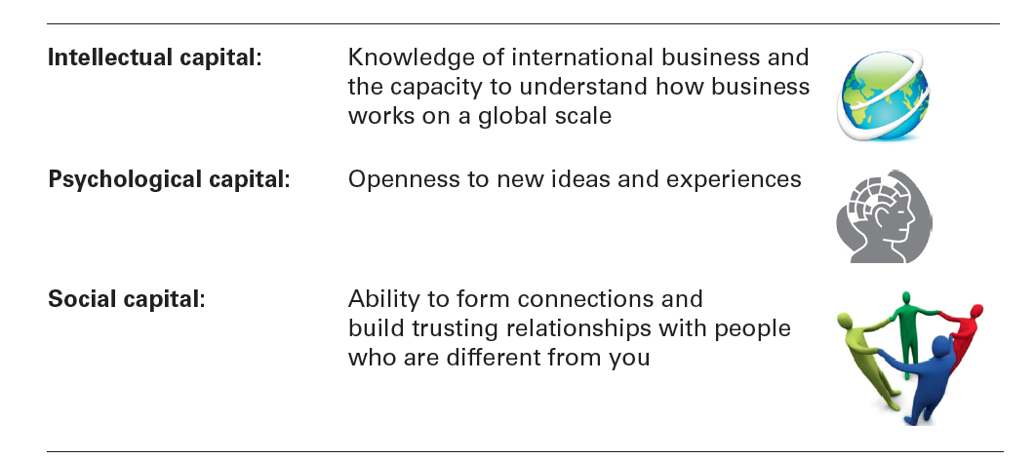
figura 4-6
A Global Mind-Set

Slide 29


